Slide 1
Group 5 Midterm Presentation
Bootstrap and Cross-Validation for Model Uncertainty in Climate Prediction Using NASA’s GISTEMP v4 data
Cesar Vasquez, Brendan Gunther, Dustin Smith

Slide 2
Objectives
Evaluate forecasting performance of ML models vs. SARIMA
Use NASA GISTEMP v4 global temperature anomalies
Apply cross-validation for model tuning
Use bootstrap methods to quantify uncertainty
Statistically compare predictive accuracy across models
Notes:
Re-state to this to one sentence and state– we hoped to be a bit later on. (Too much time taken up time series).
Why it matters
What we planned on achieving.

Slide 3
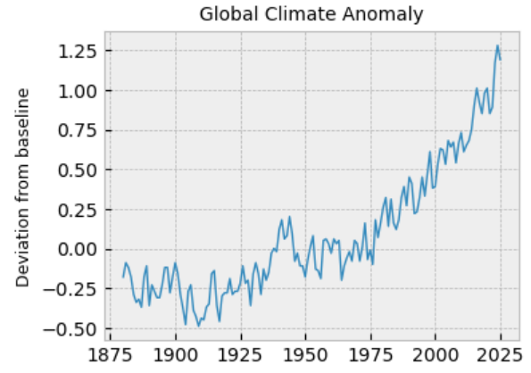
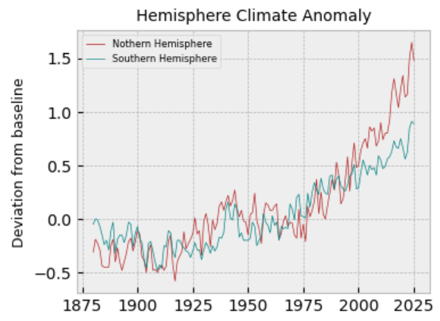
The GISTEMP v4 Data Set
Processing and Cleaning
The GISTEMP v4 data set contains global, southern, and northern hemisphere temperature C° anomalies (departures from the baseline 47C° ) from 1880-2025. The data contains 19 parameters and 149 observations for each region.
Target – Averaged Yearly anomalies (Jan - Dec)
Parameters:
Monthly anomalies
Seasonal anomalies (Averaged for 3 months)
Meteorological yearly anomalies (Dec - Nov)
Year
Notes:
We have two missing values. They occur because Meteorological yearly means take data from December of the previous year through November of the current year. In these two places, the previous change in December anomaly is not included in the data set. This caused missing data in the Dec-Nov meteorological yearly average, and the seasonal Dec–Feb data. It only occurred in year 1880 when the study first begun. Fortunately, these are data that are unlikely to be needed for analysis.
A: Average the known values and place them into the missing values (I will use this one for now).
B: Find the anomaly value and calculate the correct value.
C: Remove the year 1880.
Challenge – Keeping consistent indexing of time data

Slide 4
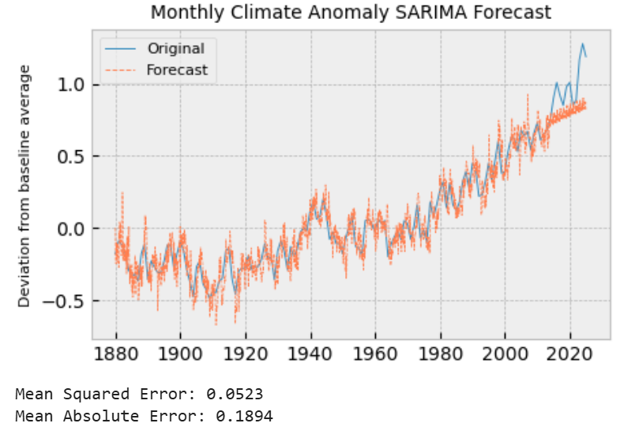
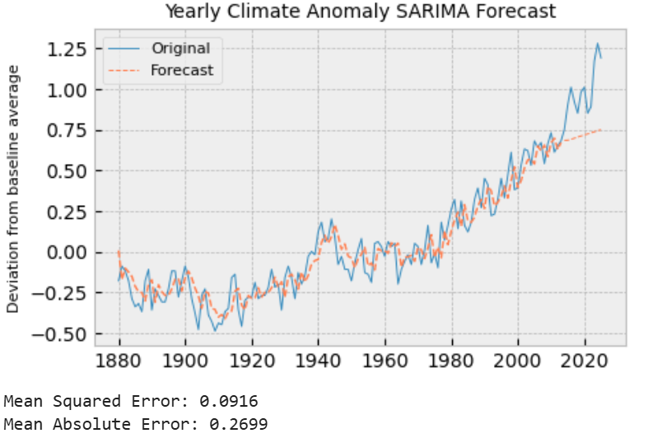
Baseline Modeling with SARIMA (Classical Statistics)
Two different models were chosen for use as a baseline for a comparison for modern methods.
Model 1: Assessing fit over all monthly parameters. SARIMA(2,1,1)x(1,1,1)x12 with drift | Model 2: Assessing fit over yearly average only. *Note: This is essentially a 12 month moving average of the model 1. * ARIMA(3,1,1) with drift
Notes:
SARIMA = Seasonal Autoregressive integrated moving average
The last 12 years were reserved to produces a baseline MSE for both data sets.
THe MSE is likely a poor choice do to the nature of squared decimals to decrease. MAE is maybe better to avoid over reduction of the loss. The Range of the data is between -1 and 2, making most estimates <1. So (estimates)^2 become excessively small.
LaTex: SARIMA (1-\phi_{1}B^{1}-\phi_{2}B^{2})(1-\Phi_{1}B^{12})(1-B)(1-B^{12})x_{t}=(1+\theta_{1}B^{1})(1+\Theta_{1}B^{12})\omega_{t}+\delta
LaTex: ARIMA (1 - \phi B^1 - \phi_{1} B^2 - \phi_{3} B^3)(1 - B)x_{t} = (1 + \theta_{1} B^1)\omega_{t} + \delta

Slide 5
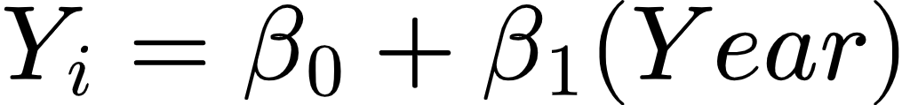
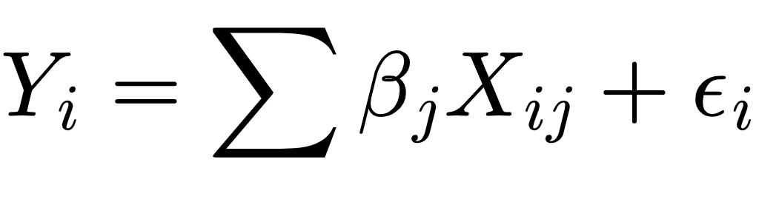
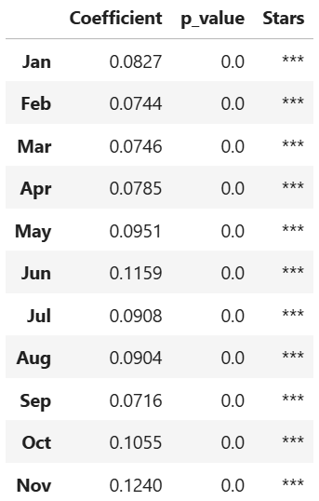
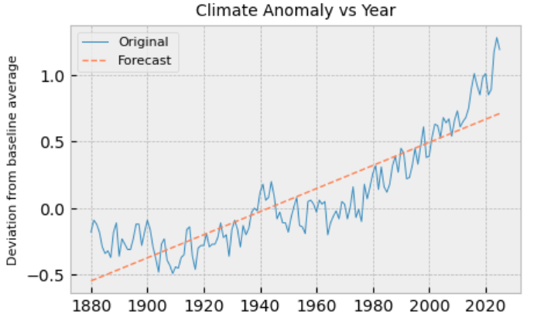
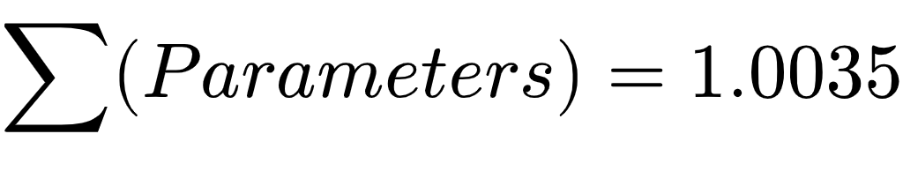
Modeling: Regression
Multiple regression where X_{ij} = month anomalies:
Everything is significant!
MSE = .000105 R² = .9997
Ordinary regression on global anomalies ~ year
This model (if the intercept is present) provides a decent fit for the data.
MSE = .037 R^{2.} = .767
No Good
Good Start
Amazing fit? Or Extreme data leakage?
Due to the nature of the data, the target and parameters are highly correlated, the target is a linear combination of the parameters, and the matrix is singular.
Notes:
The Year predictor can be expanded to polynomial expressions, and then penalized under a shrinkage method.
LASSO – May not be useful for our data. We do not have a lot of parameters to preform LASSO on, and so we may bypass this.

Slide 6
Cross Validation on Temporal Data:
Classical Cross Validation splits the data into random test and training data sets, without respect to possibility of highly correlated data. To do so masks the temporal nature of our data, and limits our predictability by removing its natural connectivity.
Comparison with the Simple Year model:
Forward-chaining (Rolling-Origin) Cross Validation:
Maintains temporal correlation
Allows for assessing future forecast test data
Akine to a Time-Series version of Leave-One-Out
Works by slowly increasing the training data sample size, while maintaining a constant test size.
Classical: .136 .181 .192 .158 .174 .151 .161 .194 .146 | Forward-Chaining: .117 .153 .282 .074 .073 .129 .237 .312 .473
Increased training size
Decreased forecast dependability.

Slide 7
Forward-Chaining in practice:
Before further advancement in machine learning methods (polynomial, neural nets, tree based models, LDA. ect) it is useful to examine train-test-splitting for model comparison.
Recall the earlier model using Year as our predictor.
Classical CV: | Forward-Chaining CV
Fold | Train/ Test | MAE | Fold | Train/ Teat | MAE
1 | 90/10% | .136 | 6 | 90/10% | .151
2 | 90/10% | .181 | 7 | 90/10% | .161
3 | 90/10% | .192 | 8 | 90/10% | .194
4 | 90/10% | .158 | 9 | 90/10% | .146
5 | 90/10% | .174 |  | R² | .7795
Fold | Train/ Test | MAE | Fold | Train/ Teat | MAE
1 | 11/9% | .117 | 6 | 64/9% | .129
2 | 20/9% | .153 | 7 | 73/9% | .237
3 | 38/9% | .282 | 8 | 82/9% | .312
4 | 47/9% | .074 | 9 | 91/9% | .473
5 | 55/9% | .073 |  | R² | .7362

Slide 8
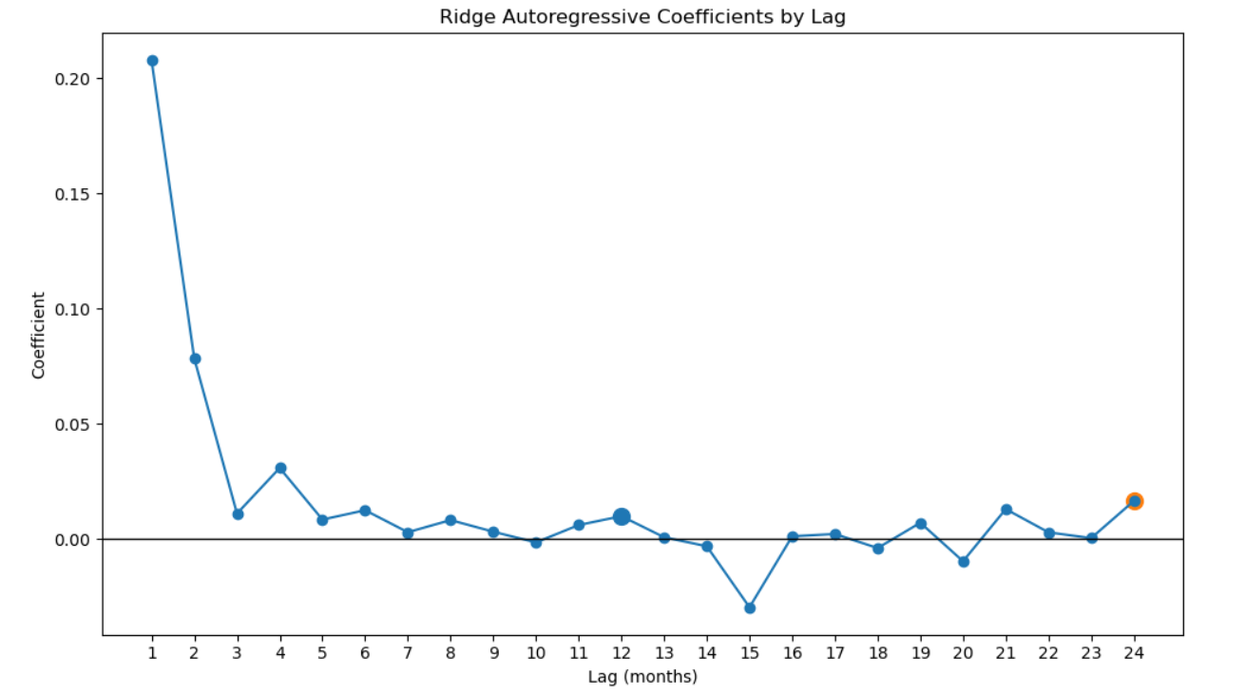
Regularized Autoregression Confirms Persistent Climate Memory
Both LASSO and Ridge identify dominant short-term persistence, and modest seasonal memory:
Dominant month-to-month persistence (lag 1 ≈ 0.21)
Gradual decay across subsequent months
Mild annual and biannual echoes (lags 12 and 24)
Ridge chosen over LASSO due to multicollinearity among lag predictors

Slide 9
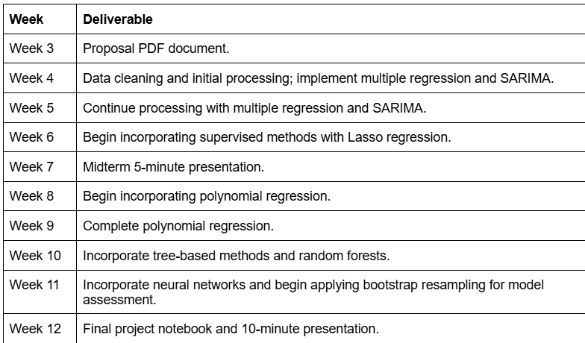
Further plans and goals
Begin fitting more sophisticated modern methods, such and Polynomial regression with LASSO or model selection.
Incorporate other methods such as LDA, Tree Based Methods, and Neural Networks
Begin building Bootstrapped confidence intervals to provide testing against the SARMIA baseline.
Notes:
Obstacles –

Slide 10


